Slide 1
MMA 867 Predictive Analytics Regression
Master of Management Analytics Jue Wang

Slide 2
Predicting the Price of Individual Diamond
Every diamond is unique, and thus is priced individually based on its attributes (Carat weight, color, clarity, etc.).
The file “Diamond.csv” contains the information of 6000 diamonds sold in the past. The attributes of each diamond are recorded along with its selling price.

Slide 3
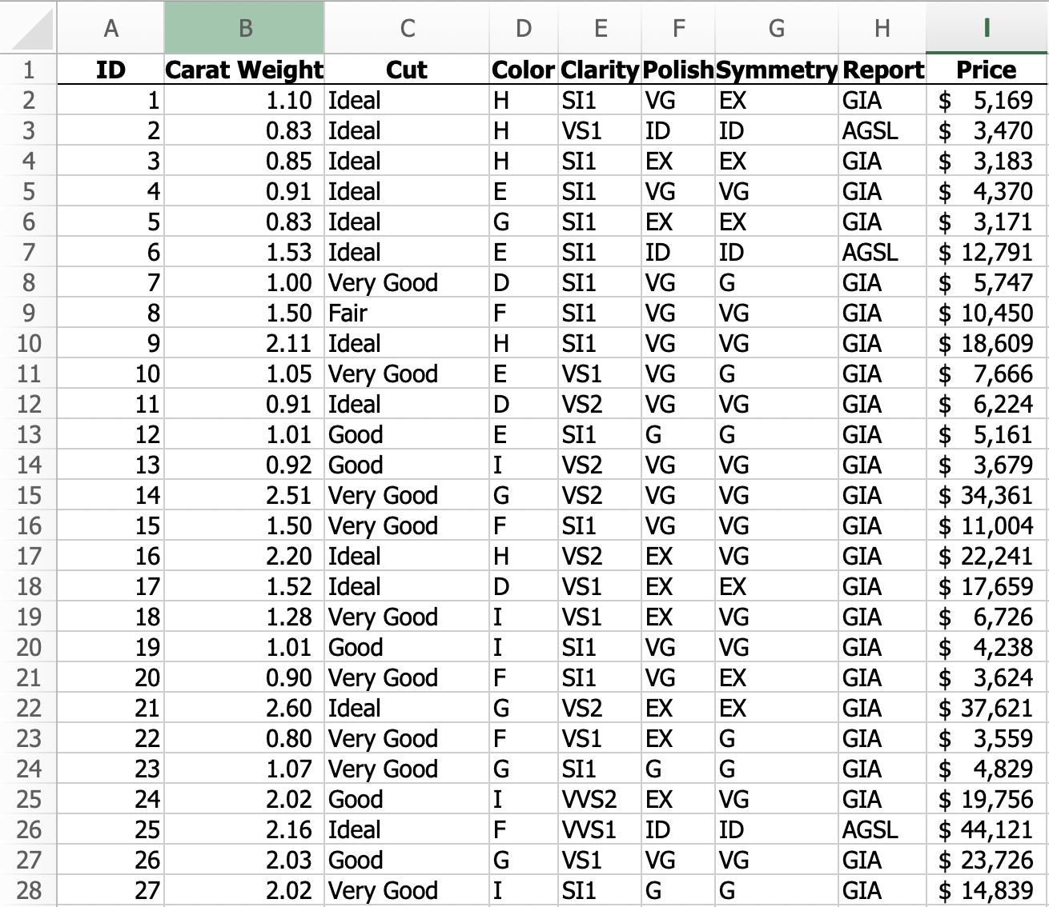
Diamond Data

Slide 4
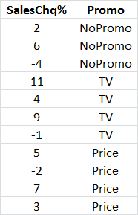
Module 3: Dealing with categorical predictors
Let’s first consider a simple dataset “ANOVA Example 1” (download from the course website)
One predictor (treatment) with three levels: NoPromo, TV, Price.
One response variable: SalesChg%.
Predict the response of a new treatment (e.g., TV).

Slide 5
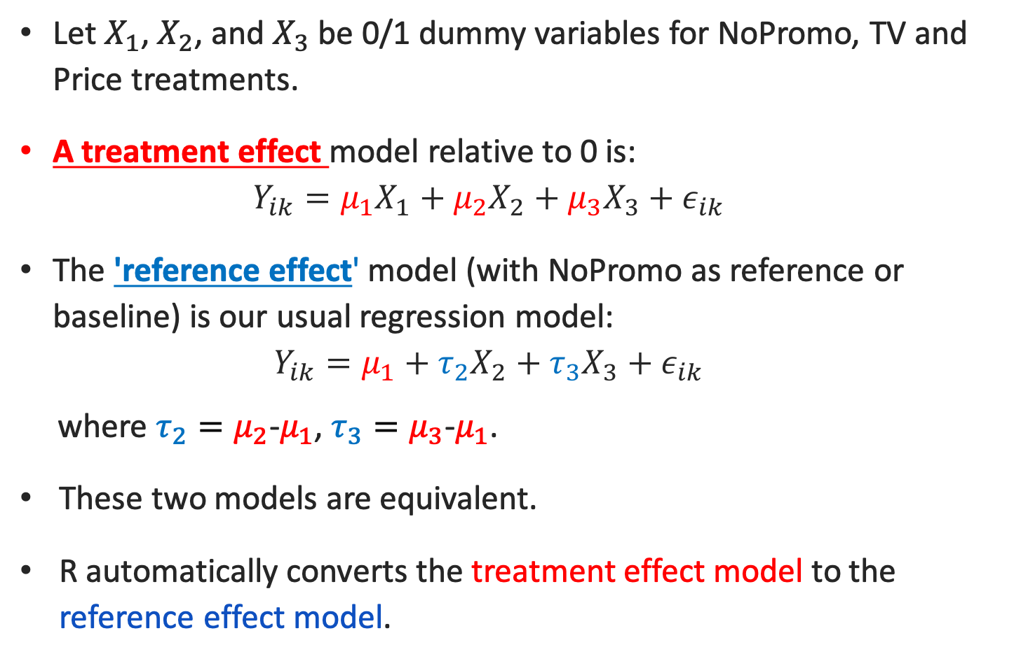
Introducing Dummy Variables
Let $X_{1}$, $X_{2}$, and $X_{3}$ be 0/1 dummy variables for NoPromo, TV and Price treatments.
A treatment effect model relative to 0 is:
$$Y_{ik}=μ_{1}X_{1}+μ_{2}X_{2}+μ_{3}X_{3}+ε_{ik}$$
The 'reference effect' model (with NoPromo as reference or baseline) is our usual regression model:
$$Y_{ik}=μ_{1}+τ_{2}X_{2}+τ_{3}X_{3}+ε_{ik}$$
where $τ_{2}=μ_{2}$-$μ_{1}$, $τ_{3}=μ_{3}$-$μ_{1}$.
These two models are equivalent.
R automatically converts the treatment effect model to the reference effect model.

Slide 6
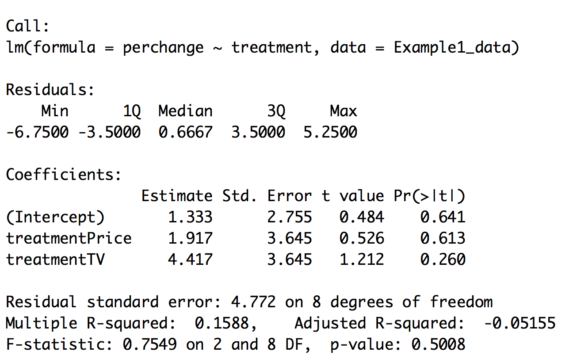
Linear Regression in R
Example1.fit<-lm(perchange~treatment,data=Example1_data) Summary(Example1.fit)

Slide 7
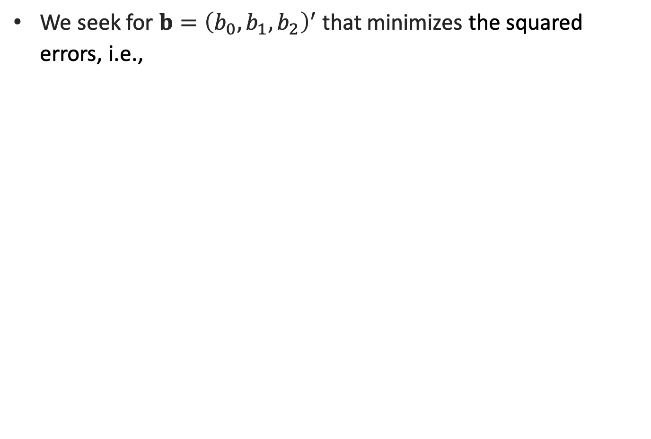
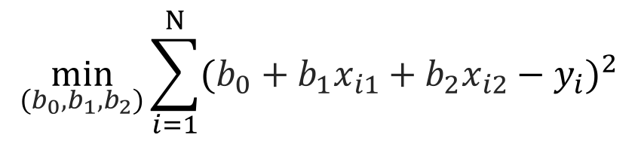
Ordinary Least Squares (OLS)
We seek for $b={\left(b_{0},b_{1}, b_{2}\right)}^{′}$ that minimizes the squared errors, i.e.,
$$\min_{(b_{0},b_{1}, b_{2})}{\sum_{i=1}^{N}{{(b_{0}+b_{1}x_{i1}+b_{2}x_{i2}−y_{i})}^{2}}}$$

Slide 8
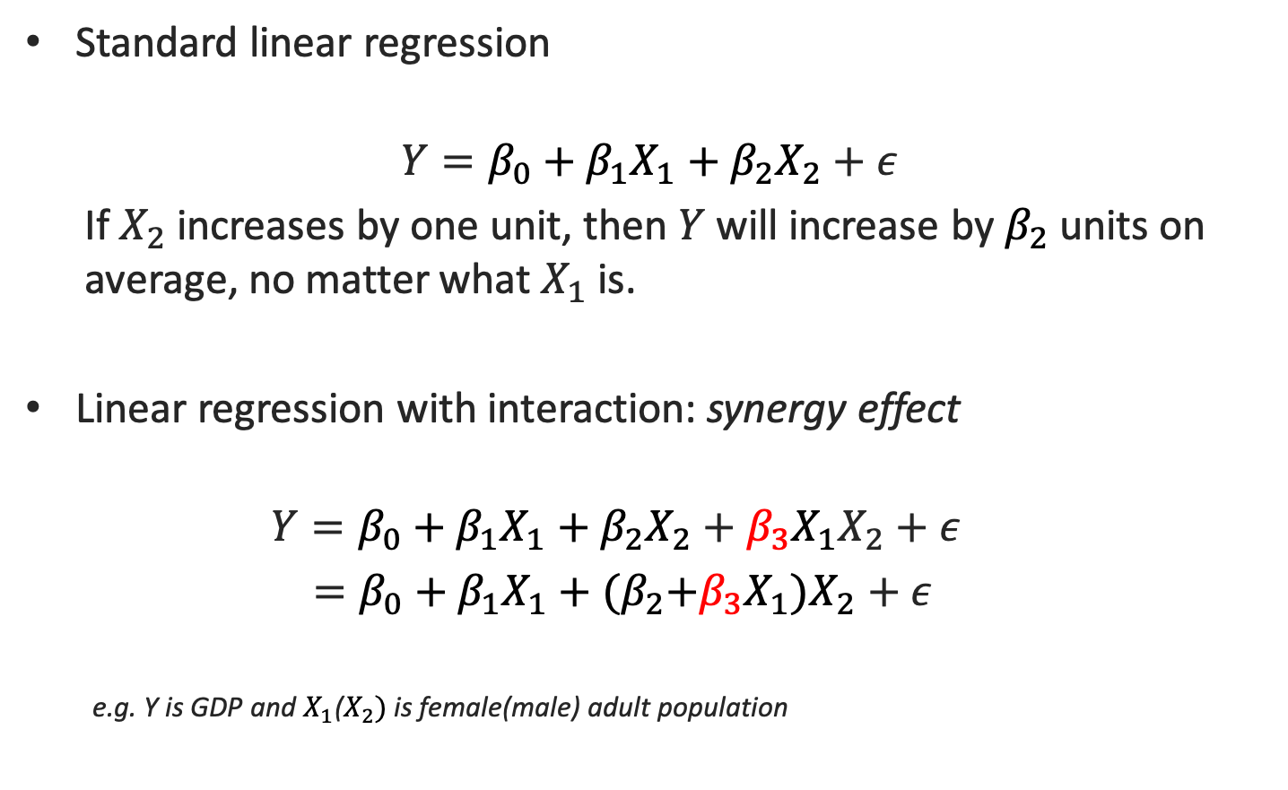
Interactions
Standard linear regression
$$Y=β_{0}+β_{1}X_{1}+β_{2}X_{2}+ε$$
If $X_{2}$ increases by one unit, then $Y$ will increase by $β_{2}$ units on average, no matter what $X_{1}$ is.
Linear regression with interaction: synergy effect
$$Y=β_{0}+β_{1}X_{1}+β_{2}X_{2}+β_{3}{X_{1}X}_{2}+ε$$
$=β_{0}+β_{1}X_{1}+{(β}_{2}+β_{3}X_{1})X_{2}+ε$
e.g. Y is GDP and $X_{1}$($X_{2})$ is female(male) adult population

Slide 9
Group Discussion #2
Open the “Group Session 1-2” code in R studio.

Slide 10
Module 4: Variable Selection
In the world of "Big Data”, there are many predictors.
One can produce even more predictors by considering the interactions
In the diamond dataset, cut*color*clarity interactions result in 5*6*7=350 new variables.
Sometimes the number of predictors can be more than the number of samples.
How to decide which variables should be in the model…
Forward/backward stepwise selection
Best subset selection (mixed integer optimization)
LASSO (regularized regression)

Slide 11
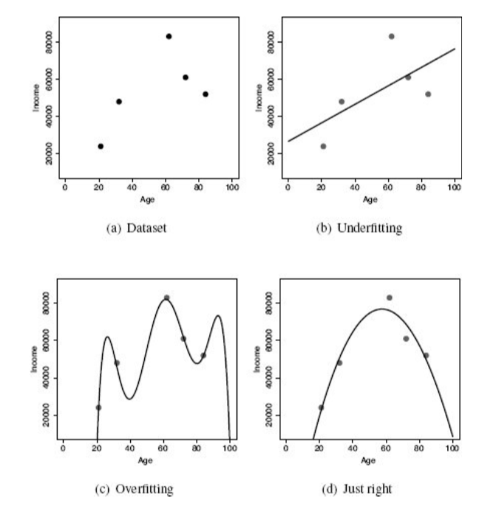
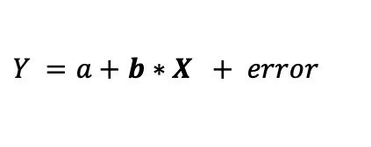
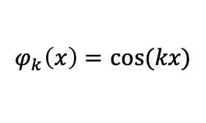
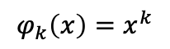
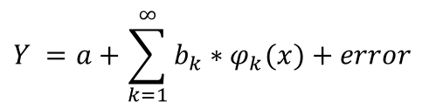
Regularizations
We can improve prediction accuracy by adding more ”features”. The downside is that we are prone to “overfitting”.
$$Y =a+b∗X + error$$
versus
$$Y =a+\sum_{k=1}^{∞}{b_{k}}∗φ_{k}(x)+error$$
$$φ_{k}\left(x\right)=x^{k}$$
For example:
$$φ_{k}\left(x\right)=cos⁡(kx)$$

Slide 12
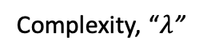
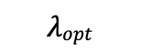
In-sample, Out-of-sample Errors vs. model complexity
Error
Out-of-sample (Prediction) Error
underfitting
In-sample (fitting) Error
overfitting
$$λopt$$
Complexity, “$λ$”
Most machine learning algorithms need optimization to find the optimal model.

Slide 13
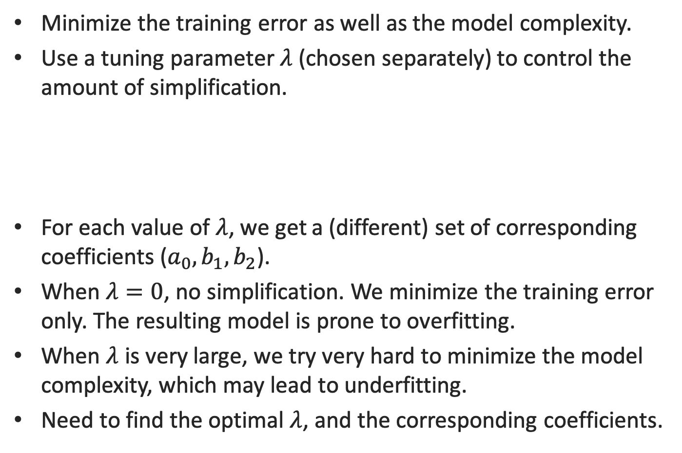
LASSO
Minimize the training error as well as the model complexity.
Use a tuning parameter $λ$ (chosen separately) to control the amount of simplification.
For each value of $λ$, we get a (different) set of corresponding coefficients (${a_{0},b}_{1}, b_{2}$).
When $λ=0$, no simplification. We minimize the training error only. The resulting model is prone to overfitting.
When $λ$ is very large, we try very hard to minimize the model complexity, which may lead to underfitting.
Need to find the optimal $λ$, and the corresponding coefficients.
$\min_{a_{0},b=(b_{1}, b_{2})}{\sum_{i=1}^{N}{{(a_{0}+b_{1}x_{i1}+b_{2}x_{i2}−y_{i})}^{2}}}$+ $λ{\left\|b\right\|}_{1}$
Training Error
Model complexity

Slide 14
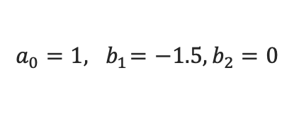
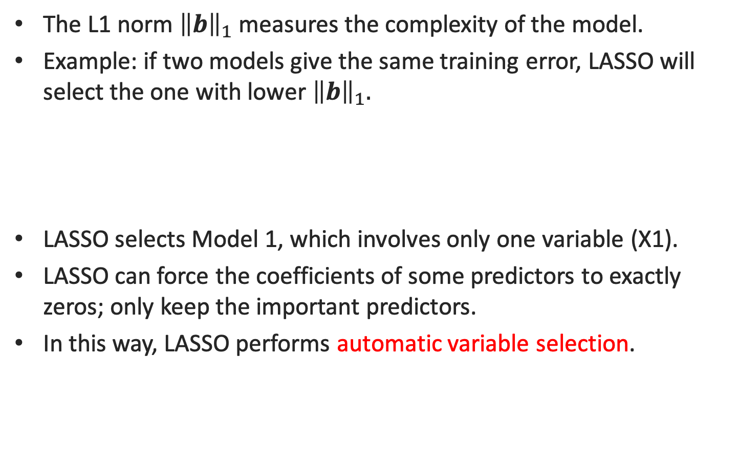
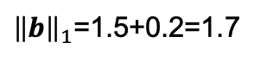
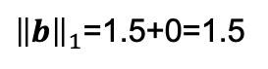
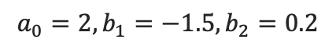
L1 norm in LASSO
The L1 norm ${\left\|b\right\|}_{1}$ measures the complexity of the model.
Example: if two models give the same training error, LASSO will select the one with lower ${\left\|b\right\|}_{1}.$
LASSO selects Model 1, which involves only one variable (X1).
LASSO can force the coefficients of some predictors to exactly zeros; only keep the important predictors.
In this way, LASSO performs automatic variable selection.
Model 1
$$a_{0}=1,{ b}_{1}=−1.5, b_{2}=0$$
Training error=0.92
${\left\|b\right\|}_{1}$=1.5+0=1.5
Model 2
$$a_{0}=2, b_{1}=−1.5, b_{2}=0.2$$
Training error=0.92
${\left\|b\right\|}_{1}$=1.5+0.2=1.7

Slide 15
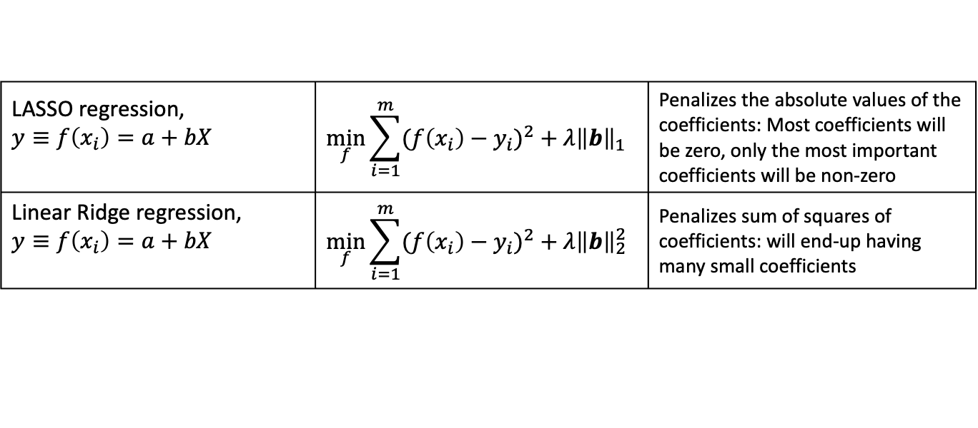
LASSO vs. Ridge Regression
LASSO regression, $$y≡f\left(x_{i}\right)=a+bX$$ | $$\min_{f}{\sum_{i=1}^{m}{{(f\left(x_{i}\right)−y_{i})}^{2}}}+λ{\left\|b\right\|}_{1}$$ | Penalizes the absolute values of the coefficients: Most coefficients will be zero, only the most important coefficients will be non-zero
Linear Ridge regression, $$y≡f\left(x_{i}\right)=a+bX$$ | $$\min_{f}{\sum_{i=1}^{m}{{(f\left(x_{i}\right)−y_{i})}^{2}}}+λ{\left\|b\right\|}_{2}^{2}$$ | Penalizes sum of squares of coefficients: will end-up having many small coefficients

Slide 16
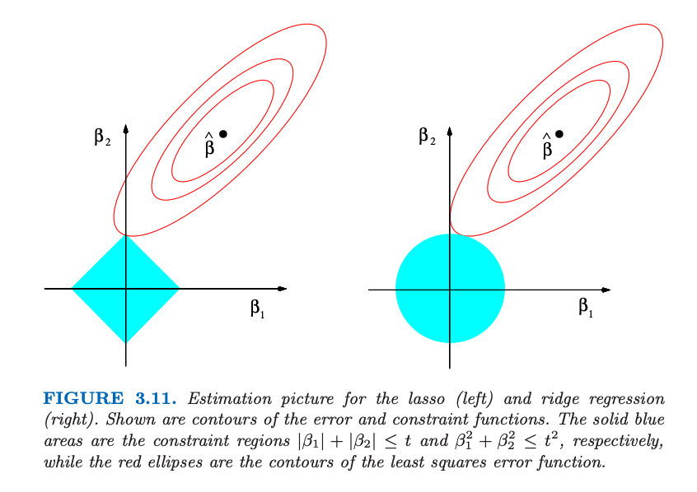
LASSO vs. Ridge Regression
From supplementary textbook (Hastie et. al.)

Slide 17
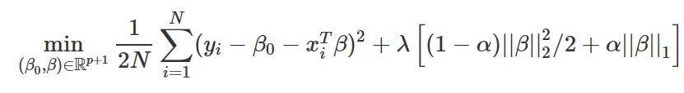
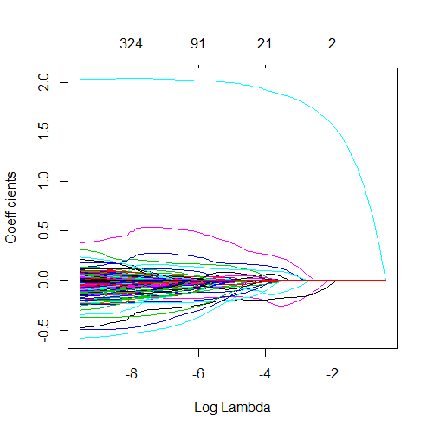
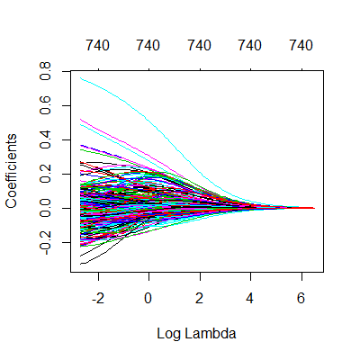
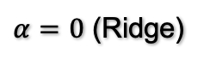
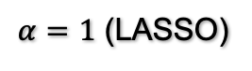
R package: glmnet
$α=1$ (LASSO)
$α=0$ (Ridge)
https://web.stanford.edu/~hastie/glmnet/glmnet_alpha.html

Slide 18
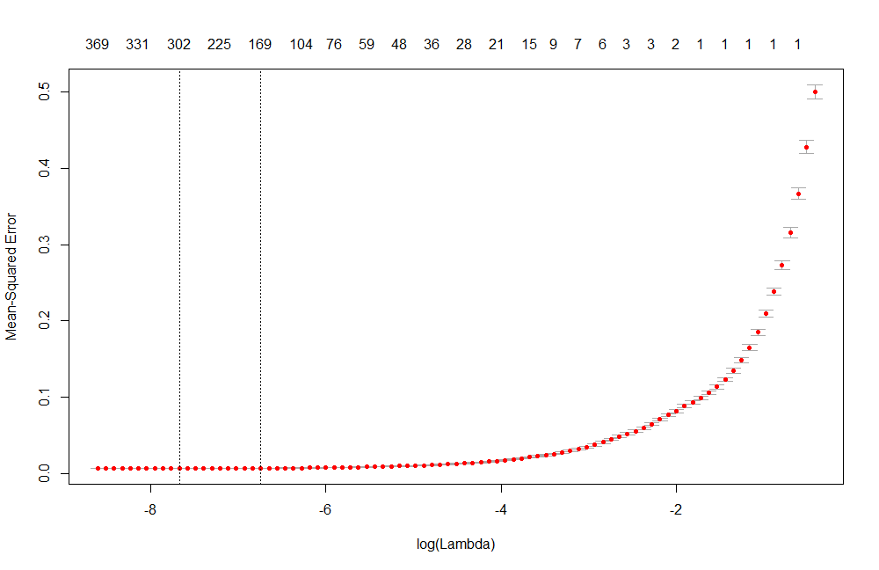

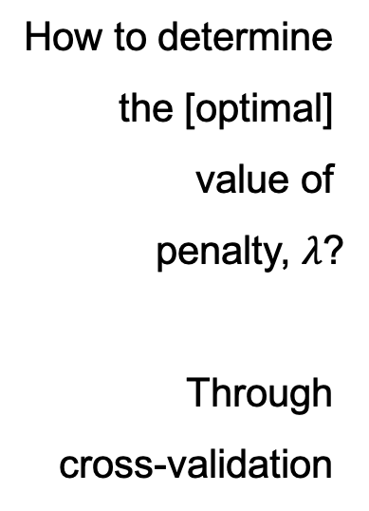
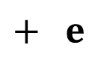
Understanding LASSO/Ridge: selecting $λ$
Number of variables in the model
How to determine
the [optimal]
value of
penalty, $λ$?
Through
cross-validation
Confidence interval for MSE
Confidence interval for the optimal $λ$

Slide 19
Cross Validation

Slide 20
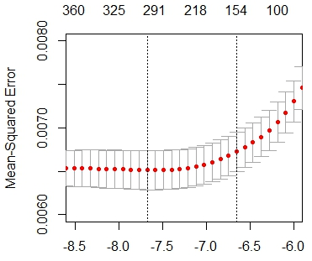

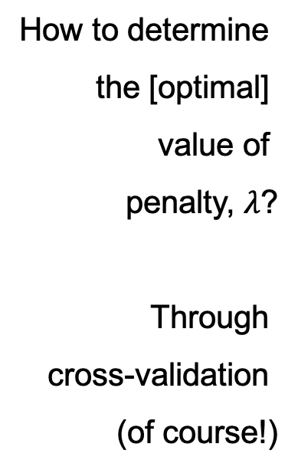
Understanding LASSO/Ridge: selecting $λ$
Number of variables in the model
How to determine
the [optimal]
value of
penalty, $λ$?
Through
cross-validation
(of course!)
Confidence interval for MSE
Confidence interval for the optimal $λ$
zoom-in

Slide 21
LASSO vs Ridge
Neither ridge nor the LASSO will universally dominate the other.
Cross-validation can determine which works better for your data.
Ridge regression shrinks every dimension by the same proportion.
LASSO shrinks all coefficients toward zero by a similar amount, and small coefficients are shrunken all the way to zero.

Slide 22

Team Assignment 1: Kaggle Competition

Slide 23


